Slide 1
GCP KUBO Deploying Guide
Abhilash S
㈜크로센트
2018. 06

Slide 2
Agenda
GCP Infrastructure Setting
Deploying Bosh Director on GCP
Deploy LB in GCP
Deploying KUBO on GCP
KUBO Deployment Architecture on GCP
Note: This deployment Guide is targeted only Ubuntu 16.04 users.

Slide 3
1. GCP Infrastructure Setting (1/11) - Install Pre-Requirements (1/4)
Note: Install and Configure below dependencies in your Notebook.
Install gcloud cli on Ubuntu.
# export CLOUD_SDK_REPO="cloud-sdk-$(lsb_release -c -s)”
# echo "deb http://packages.cloud.google.com/apt $CLOUD_SDK_REPO main" | sudo tee -a /etc/apt/sources.list.d/google-cloud-sdk.list
# curl https://packages.cloud.google.com/apt/doc/apt-key.gpg | sudo apt-key add - # sudo apt-get update && sudo apt-get install google-cloud-sdk
Gcloud Login Credentials.
Email: abhisr.kubo@gmail.com
Password: Please Check your email
Target your Gcloud Account.
$ gcloud init
Note: In Below Output Verfication code will change at the time of your login.
Note: Select kubernetes-207123 project as shown in below output.

Slide 4
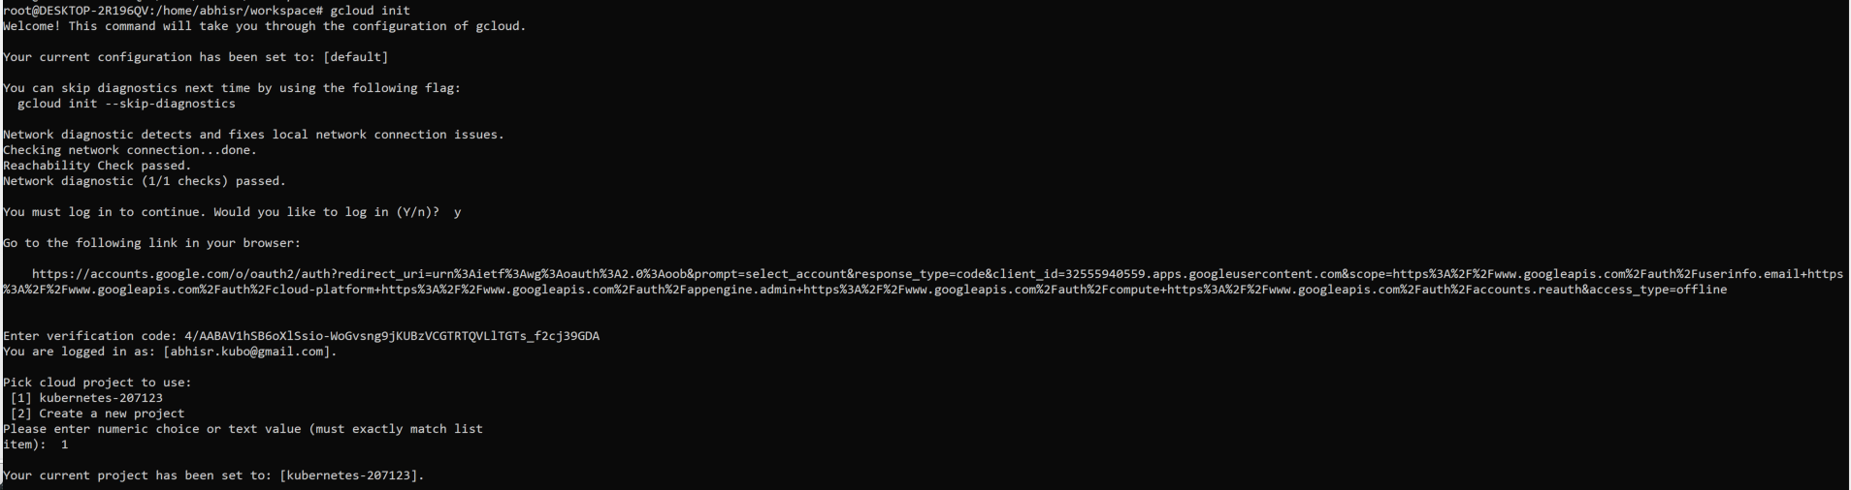
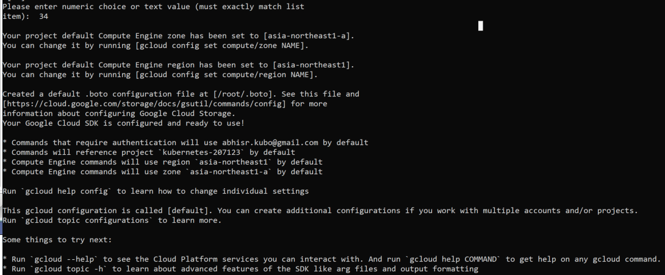
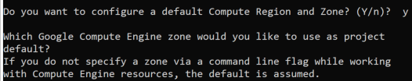
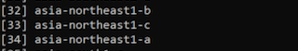
1. GCP Infrastructure Setting (2/11) - Install Pre-Requirements (2/4)
Output
Select the Region.
Note: Select [34] asia-northeast1-a
as a default zone.

Slide 5
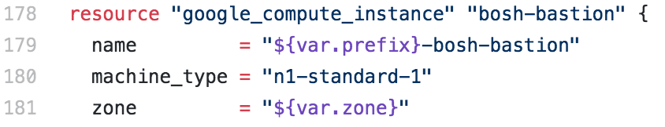
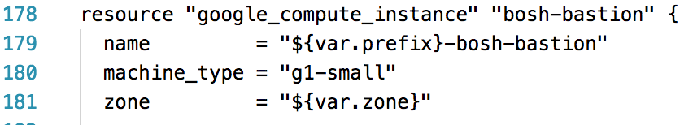
1. GCP Infrastructure Setting (3/11) - Install Pre-Requirements (3/4)
Install Terraform CLI.
$ wget https://releases.hashicorp.com/terraform/0.11.7/terraform_0.11.7_linux_amd64.zip
$ unzip terraform_0.11.7_linux_amd64.zip
$ chmod +x terraform
$ sudo mv terraform /usr/local/bin/terraform
Cloning Kubo-Deployment.
$ cd ~/workspace && mkdir gcp && cd ~/workspace/gcp
$ git clone https://github.com/cloudfoundry-incubator/kubo-deployment.git -b v0.17.0
$ cd kubo-deployment/docs/terraform/gcp/platform
Edit kubo-infrastructure.tf file to deploy inception vm.
$ vi kubo-infrastructure.tf
Before Editing
After Editing

Slide 6
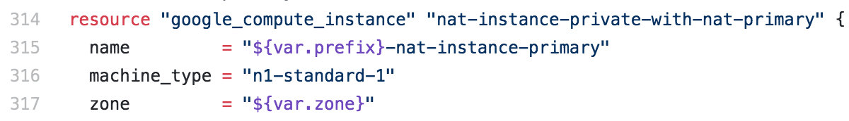
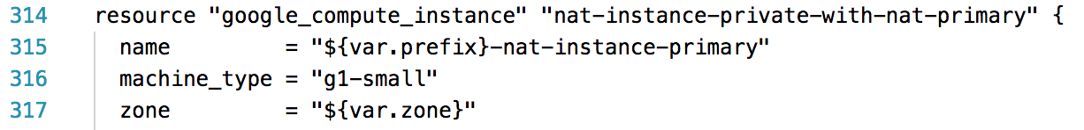
1. GCP Infrastructure Setting (4/11) - Install Pre-Requirements (4/4)
Edit kubo-infrastructure.tf file to deploy nat vm.
$ vi kubo-infrastructure.tf
Before Editing
After Editing
Install Docker on Ubuntu 16.04 .
$ sudo apt-get install apt-transport-https ca-certificates curl software-properties-common
$ curl -fsSL https://download.docker.com/linux/ubuntu/gpg | sudo apt-key add - $
$ sudo add-apt-repository "deb [arch=amd64] https://download.docker.com/linux/ubuntu $(lsb_release -cs) stable”
$ sudo apt-get update
$ sudo apt-get install -y docker-ce
$ sudo docker ps -a

Slide 7
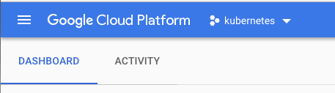
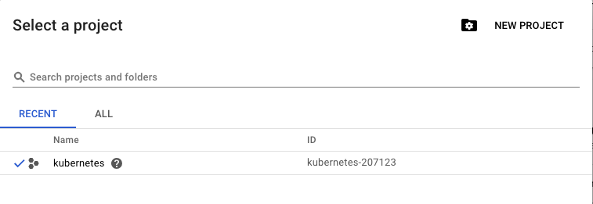
1. GCP Infrastructure Setting (5/11) - Enable and Create API’s & VPC & Service Accounts in GCP Portal (1/4)
GCP Portal URL.
$ https://cloud.google.com/
Gcloud Login Credentials.
Email: abhisr.kubo@gmail.com
Password: Please Check your email
Select You Project.
1
To Create Your Project.
2

Slide 8
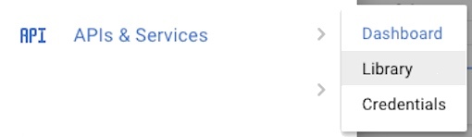
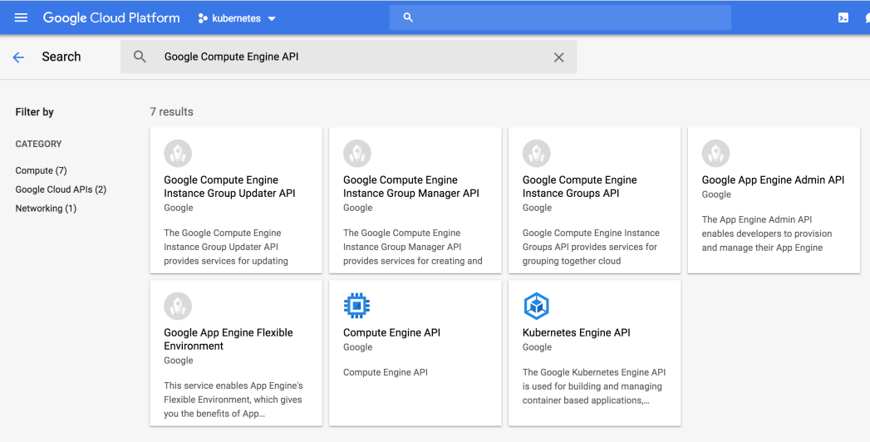
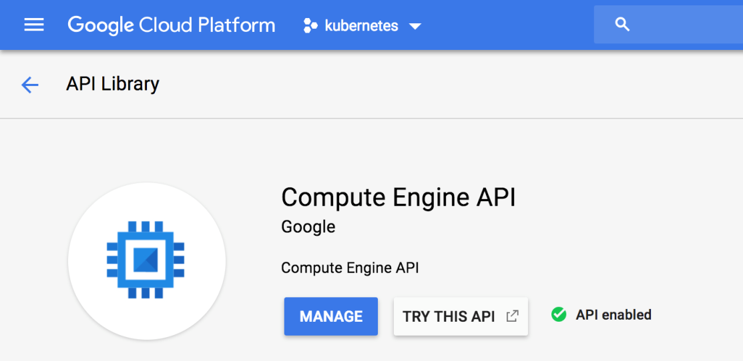
1. GCP Infrastructure Setting (6/11) - Enable and Create API’s & VPC & Service Accounts in GCP Portal (2/4)
Enable API’s from APIs & Services → Library .
1
2
Search and Enable below API’s.
1) Google Compute Engine API
2) Google Cloud Resource Manager API
3) Google Cloud Resource Manager API V2
4) Google Identity and Access Management
3
4
5
Note: Enable Remaining three API’s in same process.
Note: If API is not Enable, You can see Enable Button instead of Manage.

Slide 9
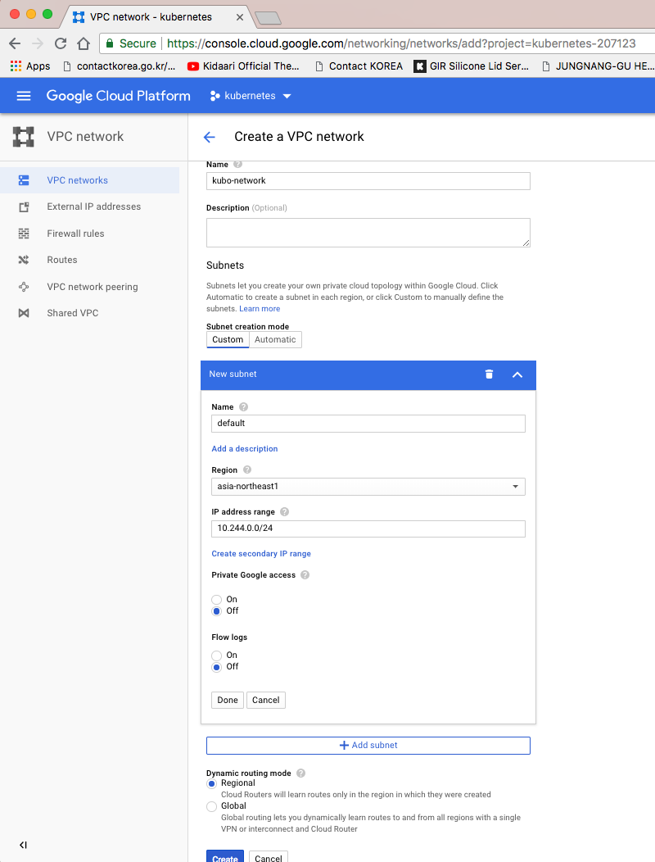
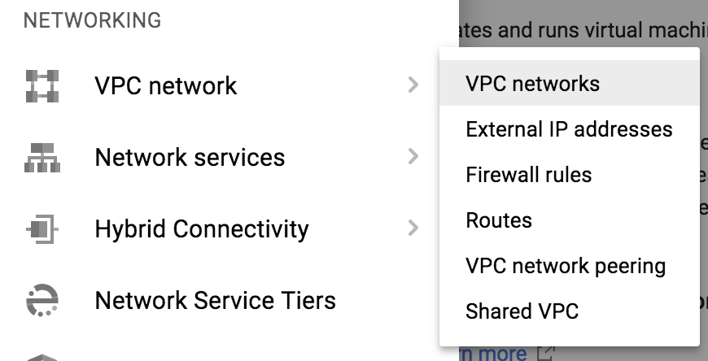
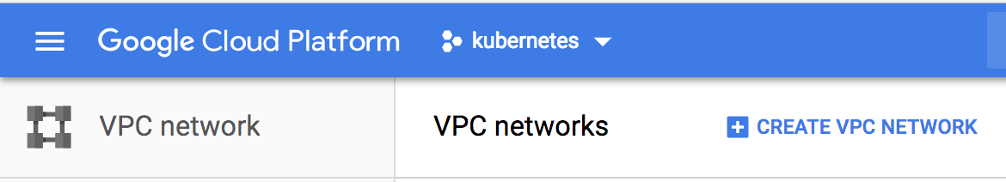
1. GCP Infrastructure Setting (7/11) - Enable and Create API’s & VPC & Service Accounts in GCP Portal (3/4)
Create VPC in GCP Portal.
1
2
4
5
6
3
7

Slide 10
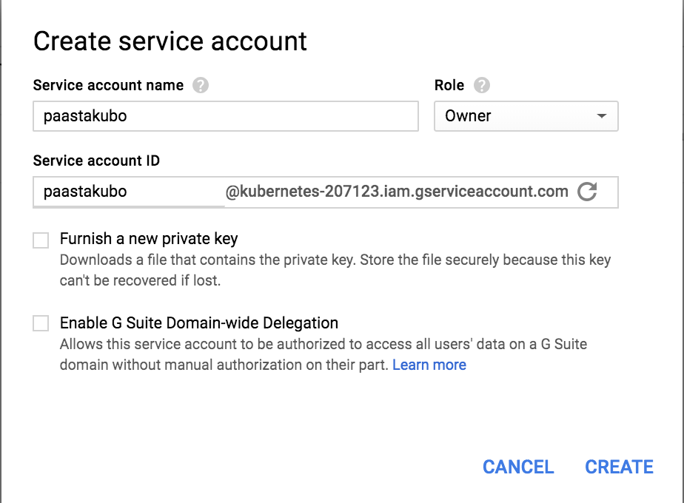
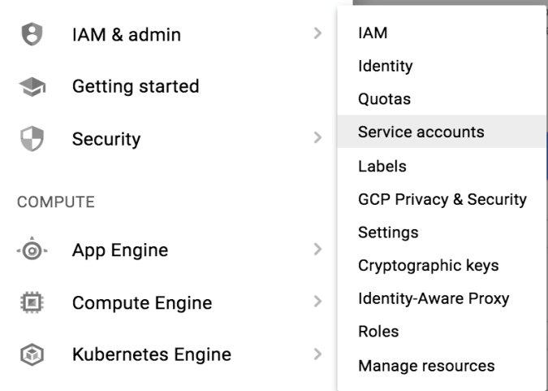
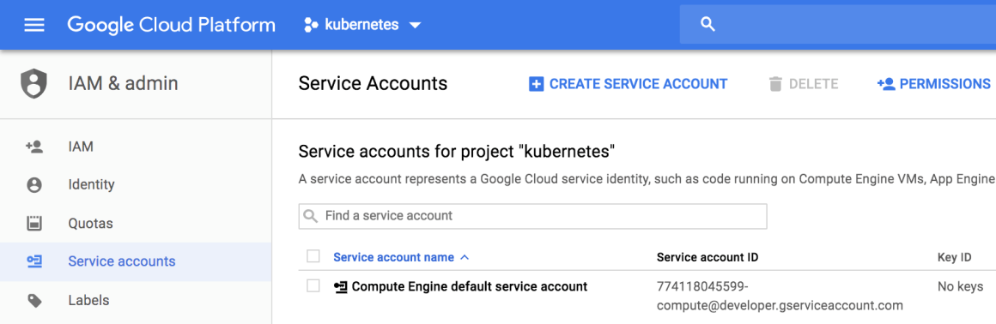
1. GCP Infrastructure Setting (8/11) - Enable and Create API’s & VPC & Service Accounts in GCP Portal (4/4)
Create GCP Service Account.
1
4
5
2
6
3

Slide 11
1. GCP Infrastructure Setting (9/11) - Deploying Inception & Nat Gateway VM’s (1/3)
Move to your kubo-deployment directory.
$ cd ~/workspace/gcp/kubo-deployment/docs/terraform/gcp/platform
Create a service account key.
$ gcloud iam service-accounts keys create ~/workspace/gcp/cfcr-tf.key.json --iam-account paastakubo@kubernetes-207123.iam.gserviceaccount.com
Note: Get your vpc name, project-id, service_account_email, region, zone created in previous sections.
Export an environment variable to deploy GCP Resources.
$ export network=kubo-network
$ export subnet_ip_prefix="10.0.1"
$ export project_id=kubernetes-207123
$ export region=asia-northeast1
$ export zone=asia-northeast1-a
$ export service_account_email=paastakubo@kubernetes-207123.iam.gserviceaccount.com
$ gcloud config set compute/zone asia-northeast1-a
$ gcloud config set compute/region asia-northeast1
$ export GOOGLE_CREDENTIALS=$(cat ~/workspace/gcp/cfcr-tf.key.json)
$ export GOOGLE_APPLICATION_CREDENTIALS= ~/workspace/gcp/cfcr-tf.key.json

Slide 12
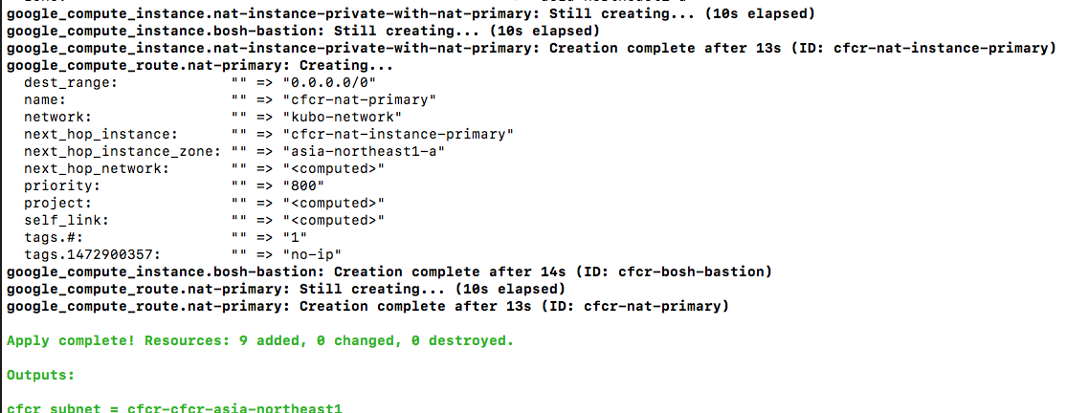
1. GCP Infrastructure Setting (10/11) - Deploying Inception & Nat Gateway VM’s (2/3)
Initialize the Terraform cloud provider.
$ sudo docker run -i -t -v $(pwd):/$(basename $(pwd)) -w /$(basename $(pwd)) hashicorp/terraform:light init
Create the inception, nat gateway and other resources
$ sudo docker run -i -t -e CHECKPOINT_DISABLE=1 -e "GOOGLE_CREDENTIALS=${GOOGLE_CREDENTIALS}" -v $(pwd):/$(basename $(pwd)) -w /$(basename $(pwd)) hashicorp/terraform:light apply -var service_account_email=${service_account_email} -var projectid=${project_id} -var network=${network} -var region=${region} -var prefix=${prefix:-cfcr} -var zone=${zone} -var subnet_ip_prefix=${subnet_ip_prefix} -state /$(basename $(pwd))/${prefix:-cfcr}.tfstate
Output
Copy the service account key to the newly created inception VM
$ gcloud compute scp ~/cfcr-tf.key.json cfcr-bosh-bastion:~/cfcr-tf.key.json

Slide 13
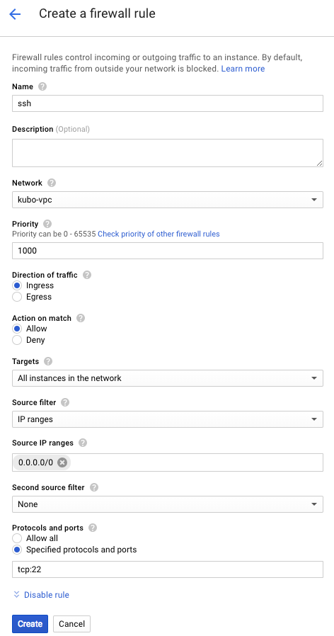
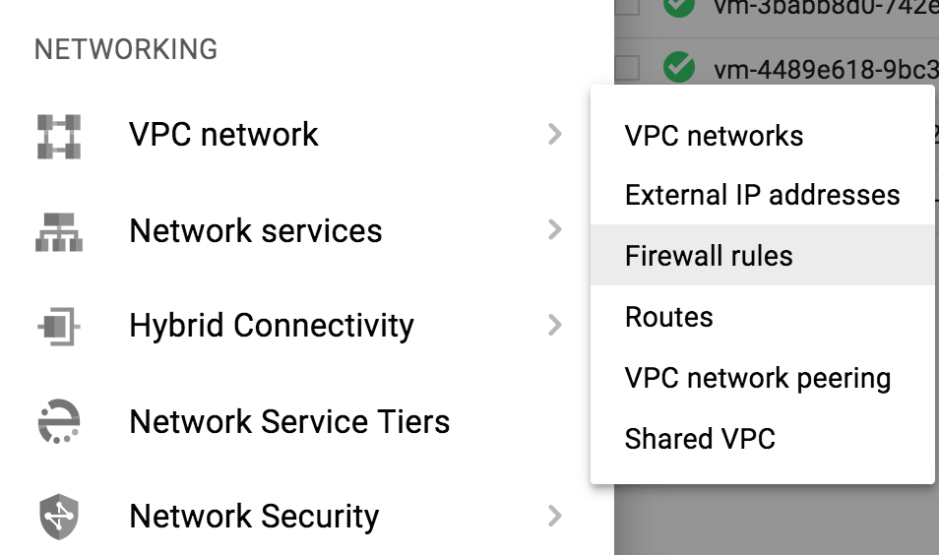
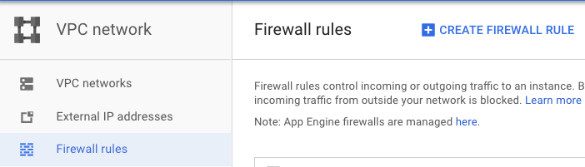
1. GCP Infrastructure Setting (11/11) - Deploying Inception & Nat Gateway VM’s (3/3)
Note: Perfrom below steps in GCP Portal.
Create Firewall Rules in GCP Portal.
1
4
2
5
6
3
7
8
9
10

Slide 14
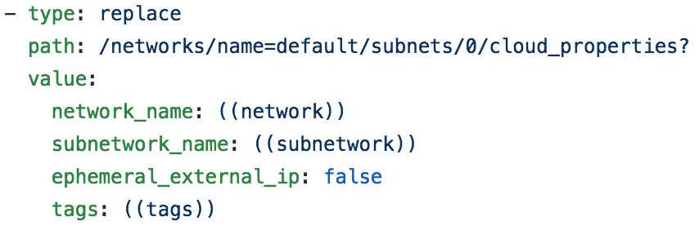
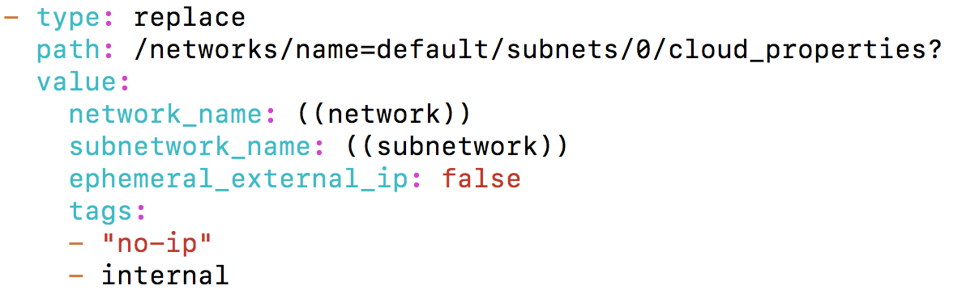
2. Deploying Bosh Director on GCP (1/5) - Deploying Bosh-Director (1/5)
Note: Perfrom below steps in your Inception.
ssh into inception
Next clone the bosh-deployment and kubo-deployment repositories
$ gcloud compute ssh cfcr-bosh-bastion
$ mkdir ~/workspace && cd ~/workspace
$ git clone https://github.com/cloudfoundry/bosh-deployment.git
$ git clone https://github.com/cloudfoundry-incubator/kubo-deployment.git -b v0.17.0
Edit GCP cpi.yml file to configure Nat VM.
$ vi ~/workspace/bosh-deployment/gcp/cpi.yml
Before Editing
After Editing
Your Nat Gateway VM Tags

Slide 15
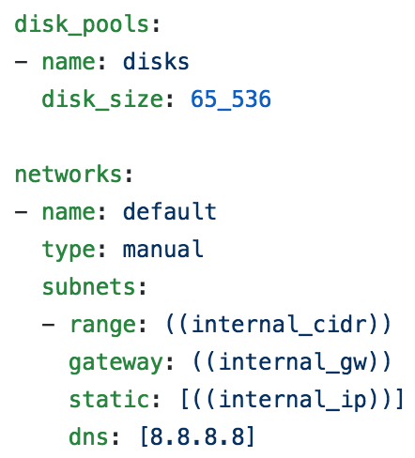
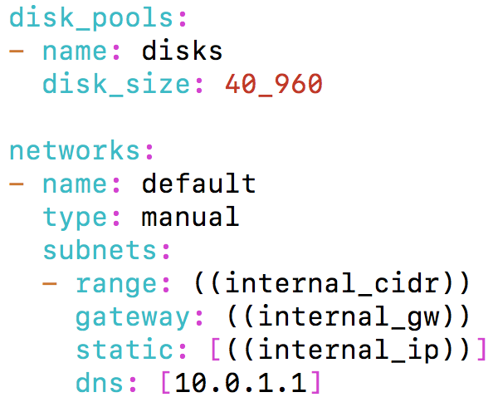
2. Deploying Bosh Director on GCP (2/5) - Deploying Bosh-Director (2/5)
Edit Bosh bosh.yml file to configure Nat VM.
$ vi ~/workspace/bosh-deployment/bosh.yml
Before Editing
After Editing
Your Subnet CIDR & Nat Gateway
Create directory to store director deployment state and credentials.
$ cd ~/workspace/bosh-deployment/ && mkdir kubo && cd kubo

Slide 16
2. Deploying Bosh Director on GCP (3/5) - Deploying Bosh-Director (3/5)
Below command create bosh-init vm on virtualbox by means of bosh.yml as base manifest.
Yaml files with –o command set variables director_name, internal_ip, internal_gw, internal_cidr, outbound_network_name using –v command.
It also create state.json to record running state and creds.yml (for certs & credentails) in your ~/deployments/vbox directory
Following Command Creates Director’s vm and install it’s jobs
$ bosh create-env ~/workspace/bosh-deployment/bosh.yml
--state=~/workspace/bosh-deployment/kubo/state.json
-o ~/workspace/bosh-deployment/gcp/cpi.yml
-o ~/workspace/bosh-deployment/gcp/service-account.yml
-o ~/workspace/bosh-deployment/jumpbox-user.yml
-o ~/workspace/bosh-deployment/uaa.yml
-o ~/workspace/bosh-deployment/credhub.yml
-o ~/workspace/bosh-deployment/local-dns.yml
--vars-store=~/workspace/bosh-deployment/kubo/creds.yml
-v director_name=”kubo"
-v internal_ip=10.0.1.252
-v internal_gw=10.0.1.1
-v internal_cidr=10.0.1.0/24
--var-file gcp_credentials_json=~/cfcr-tf.key.json
-v project_id=kubernetes-207123
-v zone=asia-northeast1-a
-v network=kubo-vpc
-v subnetwork=cfcr-cfcr-asia-northeast1
-v service_account=paastakubo@kubernetes-207123.iam.gserviceaccount.com
Check subnet name in GCP Portal

Slide 17
2. Deploying Bosh Director on GCP (4/5) - Deploying Bosh-Director (4/5)
Log into director with your alias name.
$ bosh alias-env kubo -e 10.0.1.252 --ca-cert <(bosh int ~/workspace/bosh-deployment/kubo/creds.yml --path /director_ssl/ca)
$ export BOSH_CLIENT=admin
$ export BOSH_CLIENT_SECRET=`bosh int ~/workspace/bosh-deployment/kubo/creds.yml --path /admin_password`
Create directory to download releases and stemcells
$ mkdir ~/workspace/releases && cd ~/workspace/releases
Download Upload GCP Stemcell
$ wget https://s3.amazonaws.com/bosh-core-stemcells/google/bosh-stemcell-3586.16-google-kvm-ubuntu-trusty-go_agent.tgz
$ bosh -e kubo upload-stemcell bosh-stemcell-3586.16-google-kvm-ubuntu-trusty-go_agent.tgz

Slide 18
2. Deploying Bosh Director on GCP (5/5) - Deploying Bosh-Director (5/5)
Target & Log into director credhub
$ export CREDHUB_CLIENT=credhub-admin
$ export CREDHUB_SECRET=$(bosh int --path /credhub_admin_client_secret ~/workspace/bosh-deployment/kubo/creds.yml)
$ export CREDHUB_CA_CERT=$(bosh int --path /credhub_tls/ca ~/workspace/bosh-deployment/kubo/creds.yml)
$ credhub login -s https://10.0.1.252:8844 --skip-tls-validation
List out Certificates and Passwords in credhub
$ credhub find
To Delete Certificates and Passwords in credhub
$ credhub delete -n /director_name/deployment-name/certificate-name

Slide 19
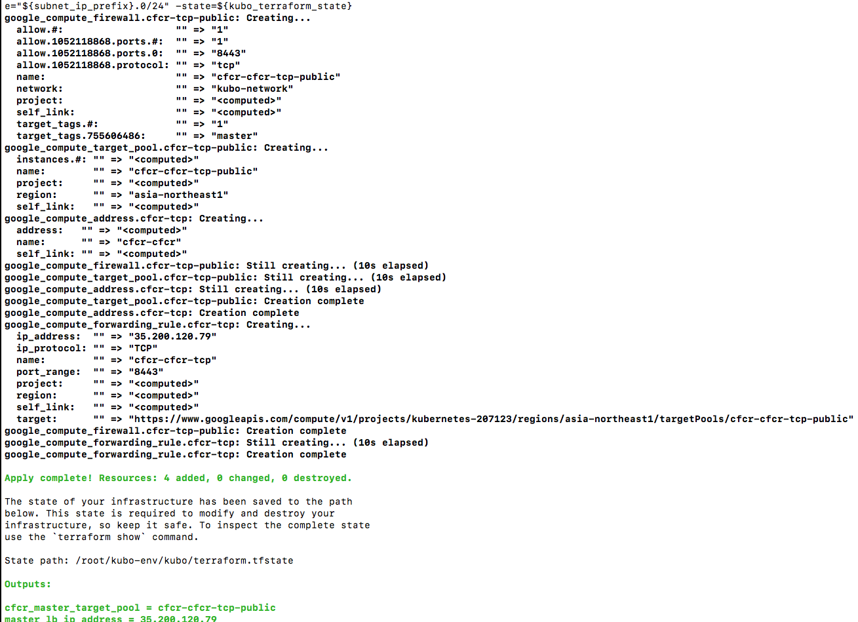
3. Deploy LB in GCP - Deploy Master Load Balancer
Note: Perfrom below steps in your Inception.
Install Load Balancer for Kubernetes Master
$ cd ~/workspace/kubo-deployment/docs/terraform/gcp/routing
$ terraform init
$ terraform apply -var network=kubo-network -var projectid=kubernetes-207123 -var region=asia-northeast1 -var ip_cidr_range="10.0.1.0/24" -state=~/workspace/terraform.tfstate
Output

Slide 20
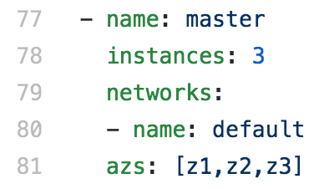
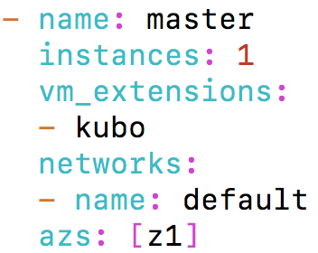
4. Deploying KUBO on GCP (1/8) - Deploying Kubo (1/5)
Download kubo-release.
$ cd ~/workspace && mkdir releases && cd ~/workspace/releases
$ wget https://github.com/cloudfoundry-incubator/kubo-release/releases/download/v0.17.0/kubo-release-0.17.0.tgz
Upload kubo-release
$ bosh -e kubo upload-release ~/workspace/releases/kubo-release-0.17.0.tgz
Edit kubo-deployment cfcr.yml file for deploying kubernetes master on GCP
$ cd ~/workspace/kubo-deployment
$ vi ~/workspace/kubo-deployment/manifests/cfcr.yml
Before Editing
After Editing
Your LB Extension Name in
Cloud-config

Slide 21
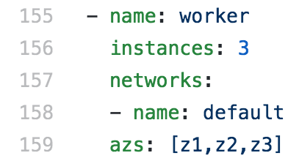
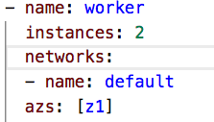
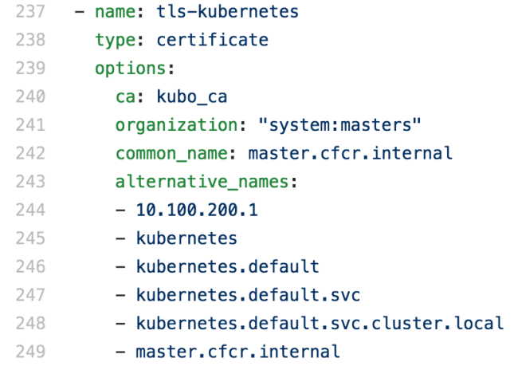
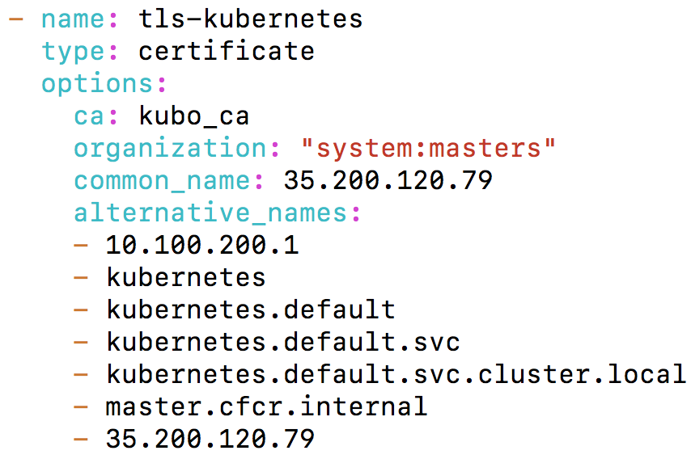
4. Deploying KUBO on GCP (2/8) - Deploying Kubo (2/5)
Edit kubo-deployment cfcr.yml file for deploying Kubernetes worker-nodes GCP
$ vi ~/workspace/kubo-deployment/manifests/cfcr.yml
Before Editing
After Editing
Edit kubo-deployment cfcr.yml file for deploying kubernetes master certificates
$ vi ~/workspace/kubo-deployment/manifests/cfcr.yml
Before Editing
After Editing
Note: Change 35.200.120.79 IP according to your LB IP.

Slide 22
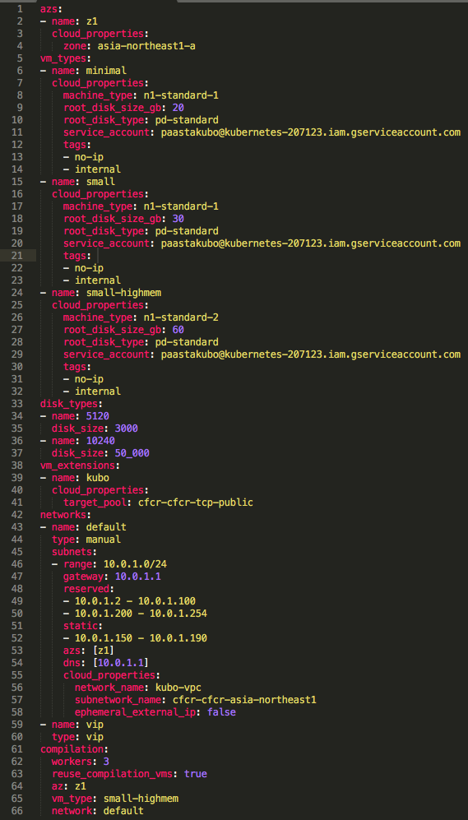
4. Deploying KUBO on GCP (3/8) - Deploying Kubo (3/5)
Create and Save bosh director cloud-config
$ vi ~/workspace/kubo-deployment/manifests/cloud-config.yml

Slide 23
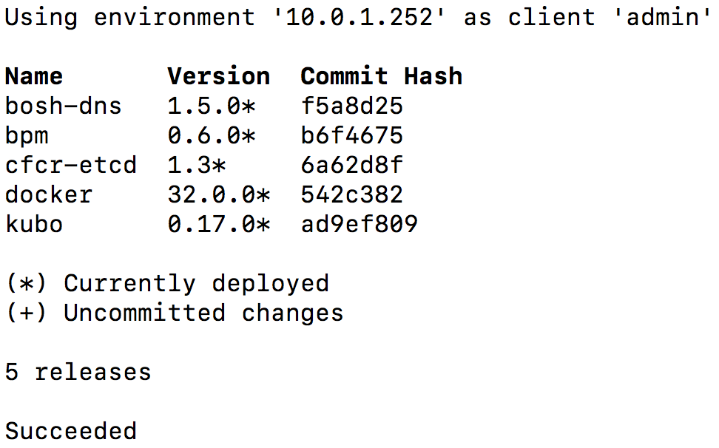
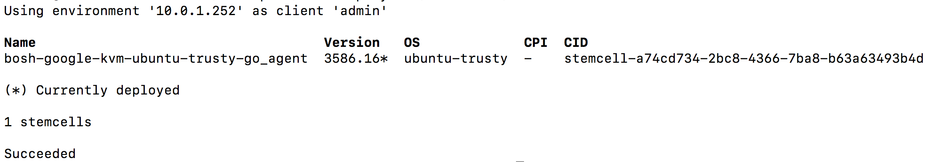
4. Deploying KUBO on GCP (4/8) - Deploying Kubo (4/5)
Update bosh director cloud-config
$ bosh -e kubo update-cloud-config ~/workspace/kubo-deployment/manifests/cloud-config.yml
Check the desired releases and stemcell to deploy kubo on GCP bosh
$ bosh -e kubo releases
Output
$ bosh -e kubo stemcells
Output

Slide 24
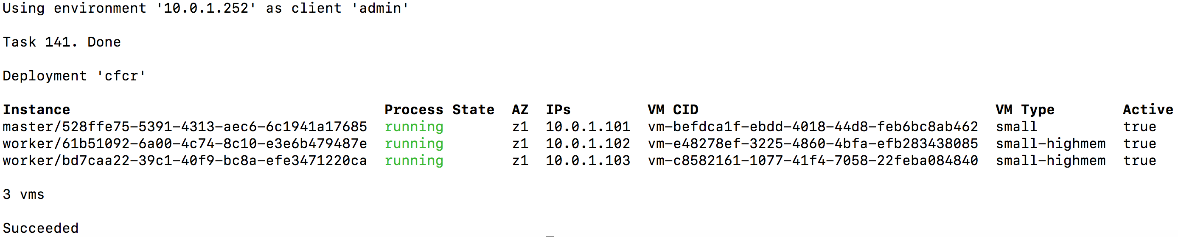
4. Deploying KUBO on GCP (5/8) - Deploying Kubo (5/5)
Deploy Kubo on gcp
$ bosh -e kubo -d cfcr deploy /home/abhisr/workspace/kubo-deployment/manifests/cfcr.yml -o /home/abhisr/workspace/kubo-deployment/manifests/ops-files/iaas/gcp/cloud-provider.yml -v project_id=kubernetes-207123 -v network=kubo-vpc -v director_name=kubo -v deployment_name=cfcr
Deploy Kubernetes add-ons
$ bosh -e kubo -d cfcr run-errand apply-specs
Check Kubernetes Deployment
$ bosh -e kubo -d cfcr vms
Output
ssh into master and work vms
$ bosh -e kubo -d cfcr ssh master
$ bosh -e kubo -d cfcr ssh worker/61b51092-6a00-4c74-8c10-e3e6b479487e

Slide 25
4. Deploying KUBO on GCP (6/8) - Accessing Kubernetes (1/3)
Download tls-kubernetes certificate from credhub
$ bosh -e kubo -d cfcr int <(credhub get -n "/kubo/cfcr/tls-kubernetes" --output-json) --path=/value/ca > ~/workspace/kubo-deployment/kubo/kubernetes.crt
Download kubo-admin-password password from credhub
$ bosh -e kubo -d cfcr int <(credhub get -n "/kubo/cfcr/kubo-admin-password" --output-json) --path=/value > ~/workspace/kubo-deployment/kubo/kubernetes_pwd.crt
Configure Kubernetes Cluster by using above Certificate (kubernetes.crt)
$ kubectl config set-cluster "dev" --server https://you-lb-publib-ip:8443 --embed-certs=true --certificate-authority=~/workspace/kubo-deployment/kubo/kubernetes.crt
Configure Kubernetes User and Context (Note: Use Kubernets User Password from above kubernetes_pwd.crt)
$ kubectl config set-credentials "dev" --token=your-kubernetes_pwd.crt-password
$ kubectl config set-context "dev" --cluster="dev" --user="dev
$ kubectl config use-context "dev"

Slide 26
4. Deploying KUBO on GCP (7/8) - Accessing Kubernetes (2/3)
Obtain kubernetes node Information
$ kubectl get node -o wide
Output
Obtain kubernetes Cluster Information
$ kubectl cluster-info
Output
Get all information regarding your Namespace
$ kubectl get pods --namespace=kube-system
$ kubectl get all -n kube-system
Check 8001 port is active on your notebook, if active kill the process
$ sudo lsof -PiTCP -sTCP:LISTEN
$ sudo kill -9 your-pid-number
Accessing to Kubernetes Dashboard
$ kubectl proxy
Starting to serve on 127.0.0.1:8001
$ http://localhost:8001/api/v1/namespaces/kube-system/services/https:kubernetes-dashboard:/proxy/#!/login

Slide 27
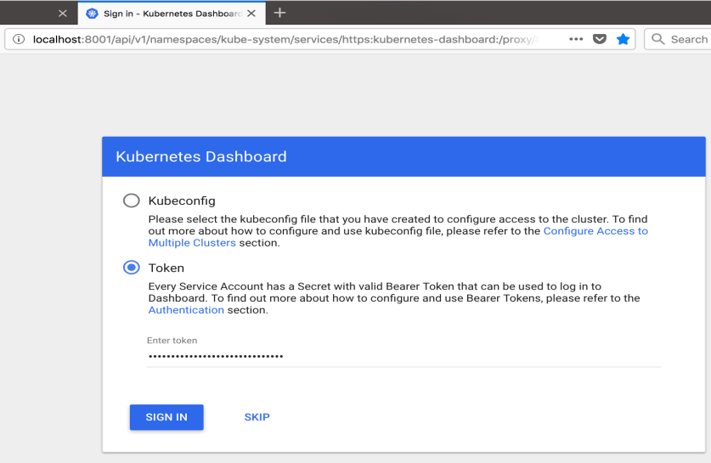
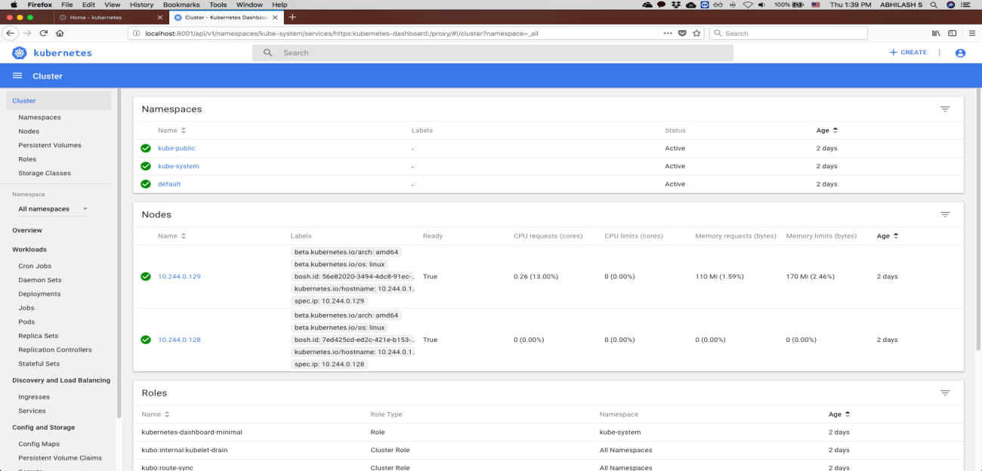
4. Deploying KUBO on GCP (8/8) - Accessing Kubernetes (3/3)
Accessing Kubernetes Dashboard in your Browser
Select token option and paste above kubernetes_pwd.crt password to login into your kubernets cluster
Output
Kubernetes Home Dashboard
Output

Slide 28
5. KUBO Deployment Architecture on GCP - Deployment Architecture
1
3
9
6
Notebook (Linux)
GCP Console Services,
Terraform CPI Setting
Terraform CPI
Create Subnet
Micro
Bosh VM
5
Docker Host
Create Firewall
Rules
Create Routes
7
Master Node VM
8
Worker Node VMs
Terraform, glcoud & docker CLI’s
Create External
IPs
Private Subnet
2
GCP Console Services,
Manual Setting
Create
Load Balancer
Create
Inception VM
4
Create Project
Public Internet Access Using
Nat & Internet Gateway DNS
Enable APIs
Create
NAT Gateway VM
Create VPC
Create Service
Accounts

Slide 29
THANK YOU

